Slide 1
Predictive Modeling of mucosal immune responses during Helicobacter pylori infection
MMI Summer School, June 2014

Slide 2
Outline
Introduction
Helicobacter pylori: the computational model
ODE-based model
ABM-based model
Results & Model validation
Sensitivity analysis
Discussion and conclusions

Slide 3
Introduction
Characteristics
- Spiral-shaped, gram negative, and microarophilic
bacterium found mainly in the stomach
- Dominant member of the human gastric microbiota
- Persistent for decades upon infection
Australian scientist Robin Warren observed again this bacterium in the stomach
“Unidentified curved bacilli in the stomach of patients with gastritis and peptic ulceration” LANCET
The Karolinska Institute awarded a Nobel Prize in Medicine to Marshall & Warren for their discoveries on H. pylori
1979
1982
1984
1994
2005
After many unsuccessful attempts to culture the bacterium, Dr. Warren, together with Dr. Barry Marshall found H. pylori colonies after a 5 days Easter vacation and a Petri Dish
The NIH recommends the triple antibiotic therapy to treat H. pylori

Slide 4
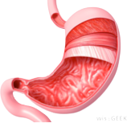
Introduction
50%
15%
85%
Asymptomatic infection
Peptic ulcers
MALT lymphoma
Adenocarcinoma

Slide 5
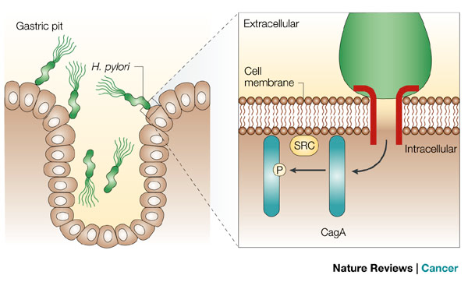
Introduction
WHY?
H. pylori’s pathogenicity islands (VacA, CagA, HtrA, OipA...)
CagA
Cytotoxin-associated gene A
Helicobacter pylori’s main virulence factor

Slide 6
Introduction
Then... what if I have H. pylori?
The standard treatment to eradicate H. pylori is the one week “triple therapy”
PROTON PUMP INHIBITOR
Omeprazole
Let’s eliminate
the bug!
Antibiotics
Clarithromycin and amoxicillin

Slide 7
Introduction
But... Is it a good idea to wipe out
all the Helicobacter strains?

Slide 8
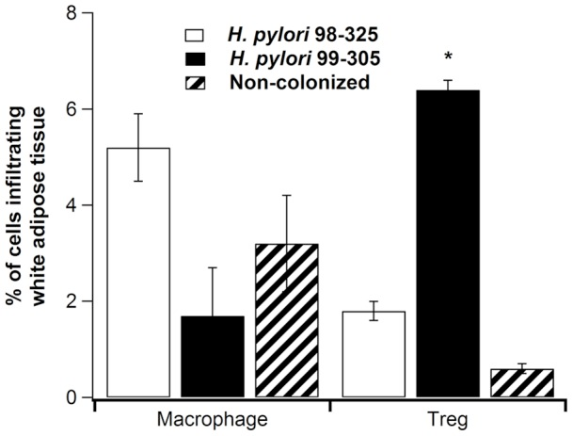
Introduction
Can H. pylori exert any
health benefits?
We hypothesized that gastric colonization with H. pylori strains differing in cagA status exert distinct effects on metabolic and inflammatory phenotypes.
Bassaganya-Riera, J., et al. (2012). "Helicobacter pylori colonization ameliorates glucose homeostasis in mice through a PPAR gamma-dependent mechanism." PLoS One 7(11): e50069.

Slide 9
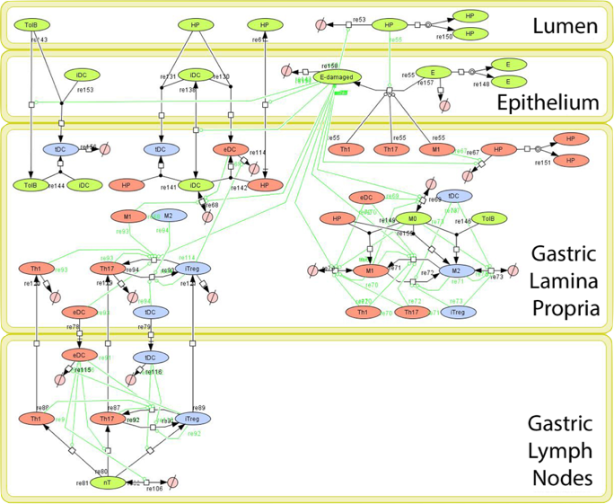
The H. pylori computational model
24 species
43 reactions
4 compartments
19 ODEs

Slide 10
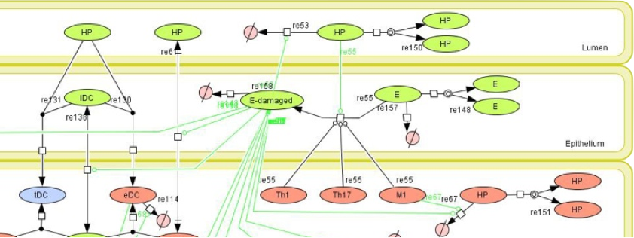
The H. pylori computational model

Slide 11
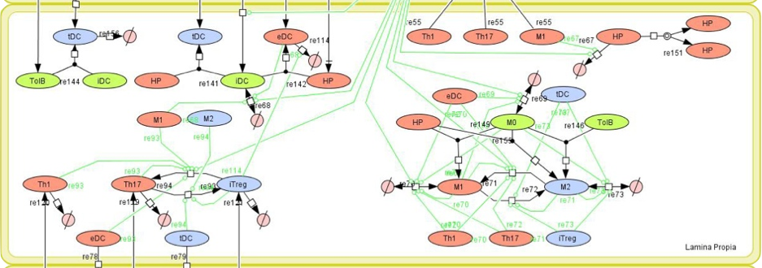
The H. pylori computational model

Slide 12
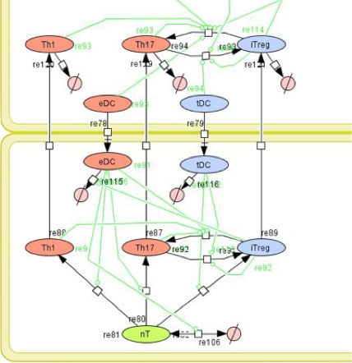
The H. pylori computational model

Slide 13
The H. pylori computational model
Ordinary Differential Equations-Based Modeling
Ideal to model DETERMINISTIC processes
Variables of equations represent average concentrations of various components of the model
Spatial differences can only be tracked using compartments
Parameter Estimation is an automated, developed process

Slide 14
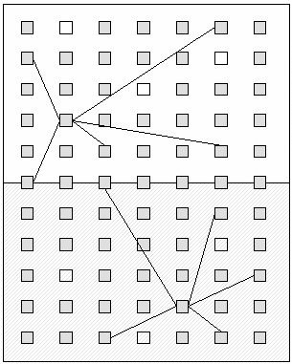
The H. pylori computational model
Agent-Based Modeling
Ideal to model STOCHASTIC processes
Accounts for individual behavior of the components of the system
Takes into account spatio-temporal dynamics using neighborhood algorithms
Parameter Estimation has to be run in trial-error fashion and there are no automated, mature strategies at the moment

Slide 15
The H. pylori computational model
Ordinary Differential Equations-Based Modeling
ENISI
ENteric Immunity SImulator
Agent-Based Modeling
COMPLEMENTARY types of modeling
that can be used SEQUENTIALLY

Slide 16
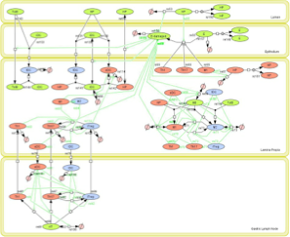
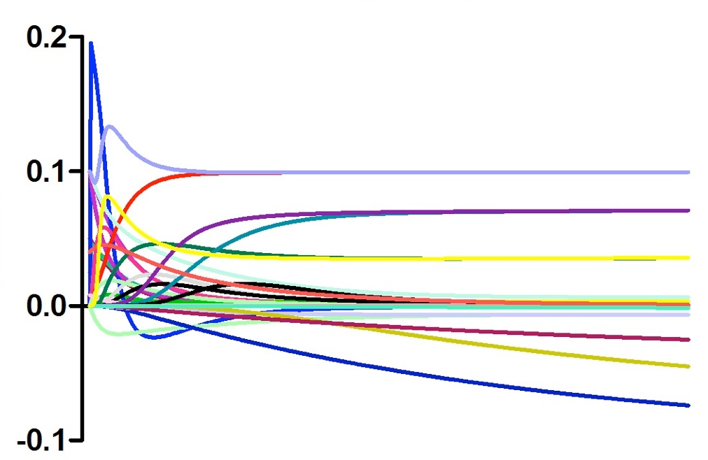
The H. pylori computational model
Ordinary Differential Equations-Based Modeling
Time course study
H. pylori 26695
CALIBRATED
MODEL
0
14
30
60
Days post infection

Slide 17
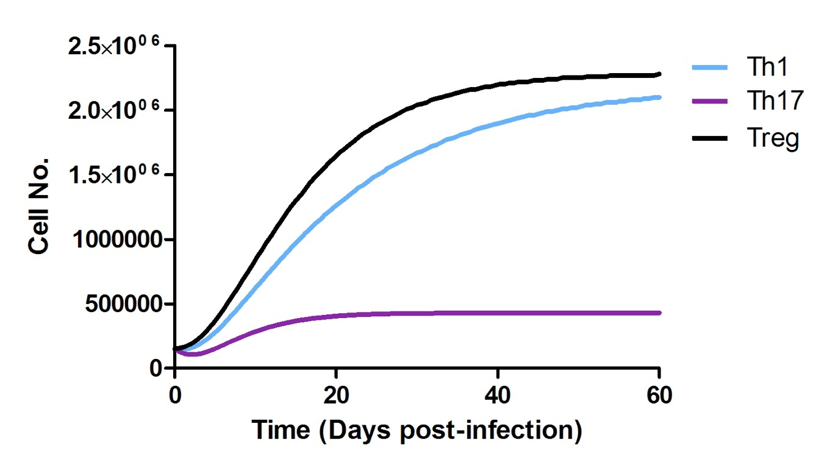
The H. pylori computational model
CD4+ T cells proliferate as a result
of infection with H. pylori

Slide 18
The H. pylori computational model

Slide 19
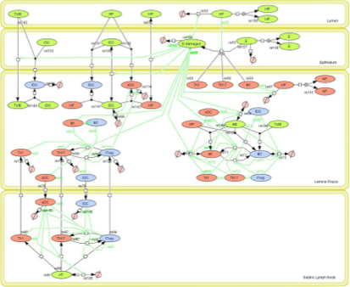
The H. pylori computational model
ENISI
ENteric Immunity SImulator
Stochastic simulator of the mucosal responses in the GI tract triggered in response to the presence of commensal or pathogenic bacteria

Slide 20
The H. pylori computational model
ENISI
ENteric Immunity SImulator
How did we move from ODE to ABM?

Slide 21
The H. pylori computational model
ENISI
ENteric Immunity SImulator
How immune subsets change over time?

Slide 22
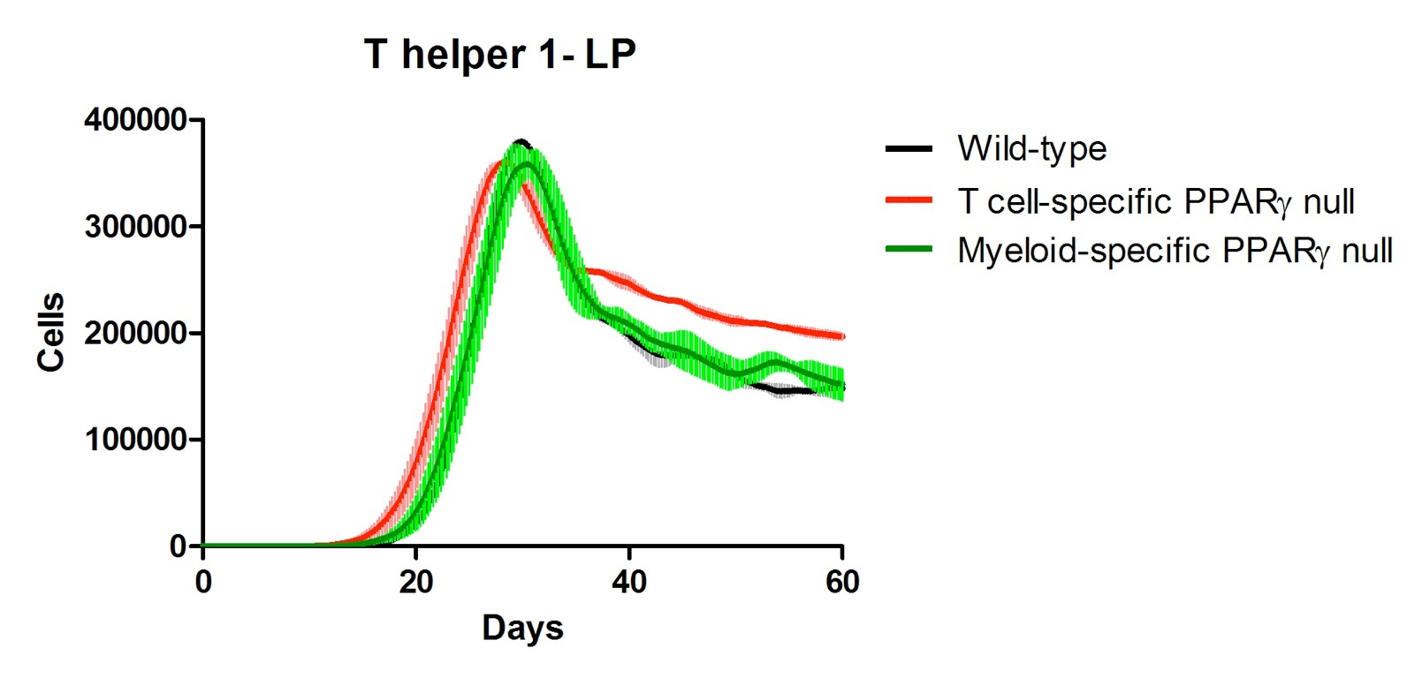
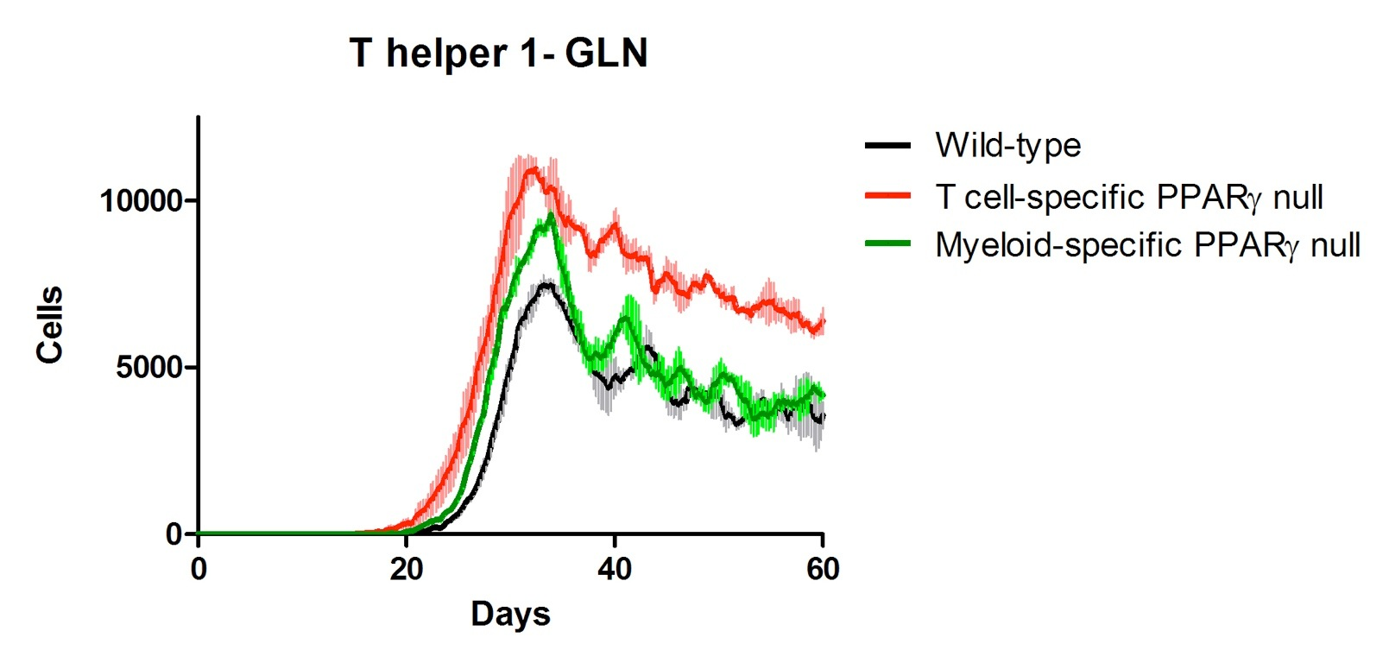
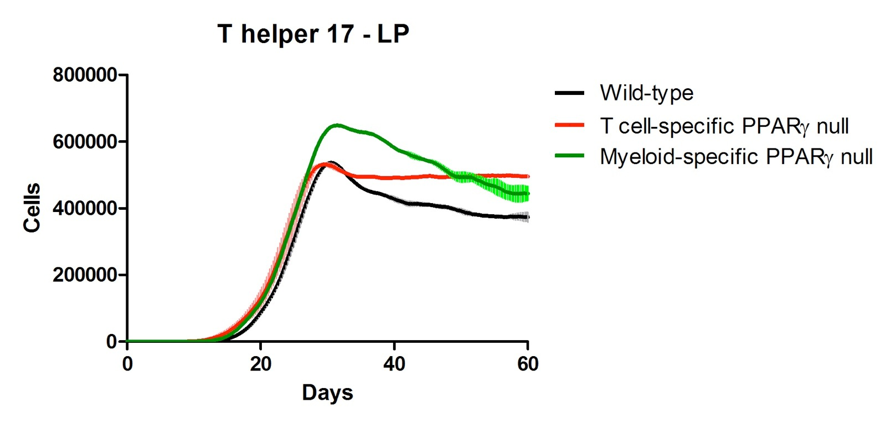
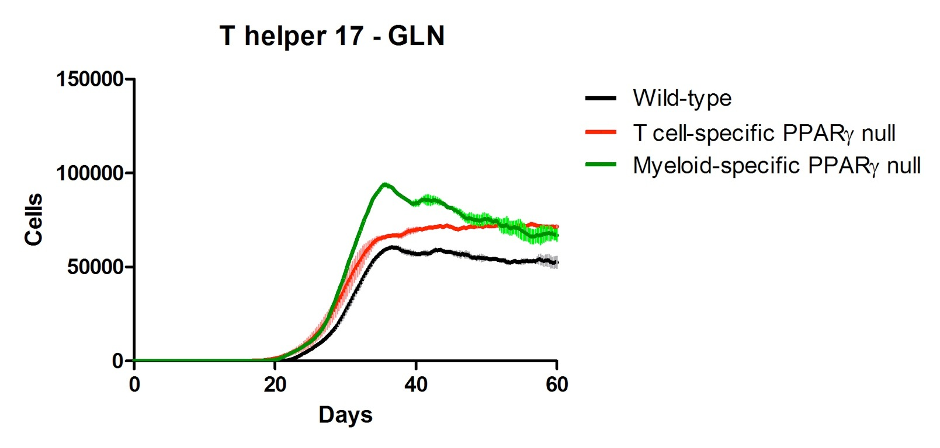
The H. pylori computational model
ENISI
ENteric Immunity SImulator

Slide 23
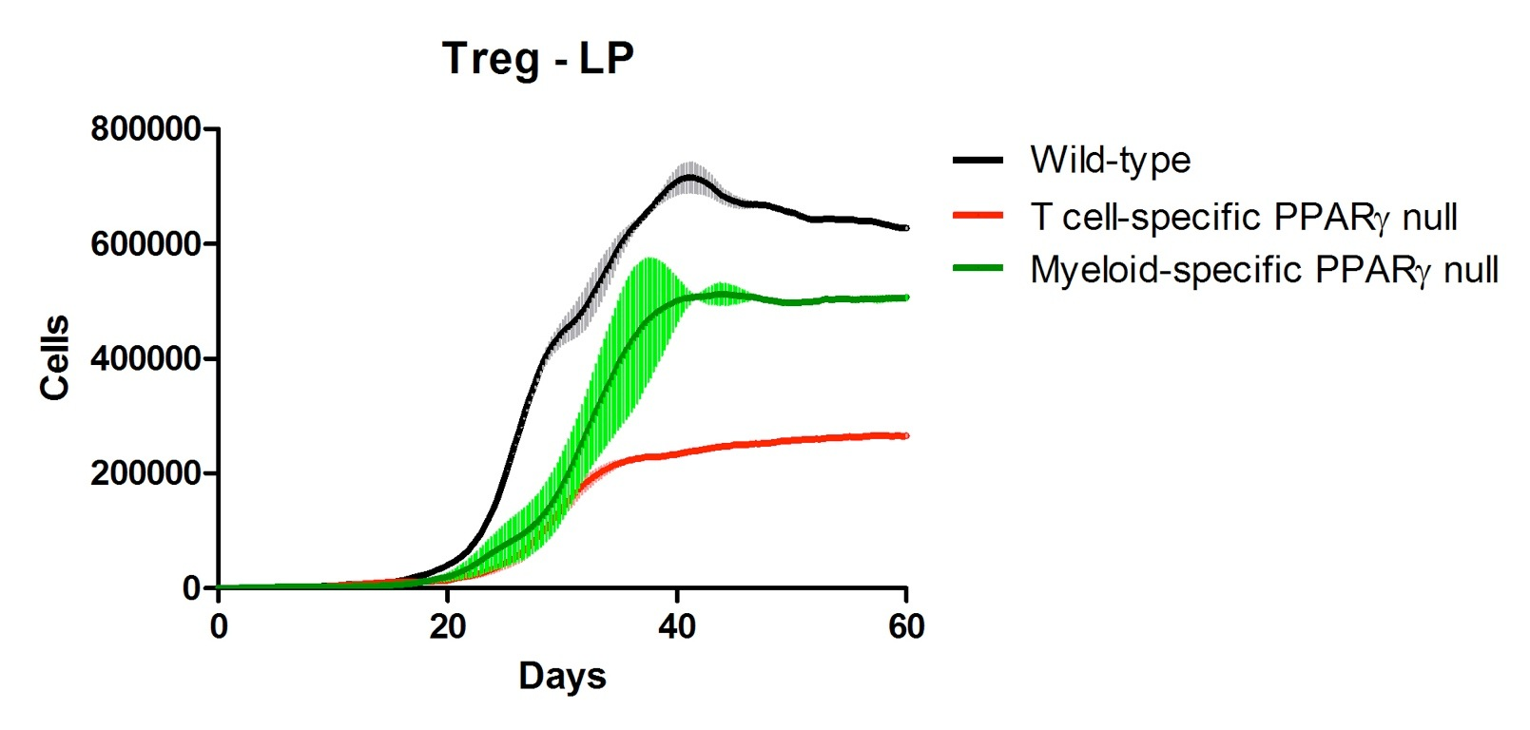
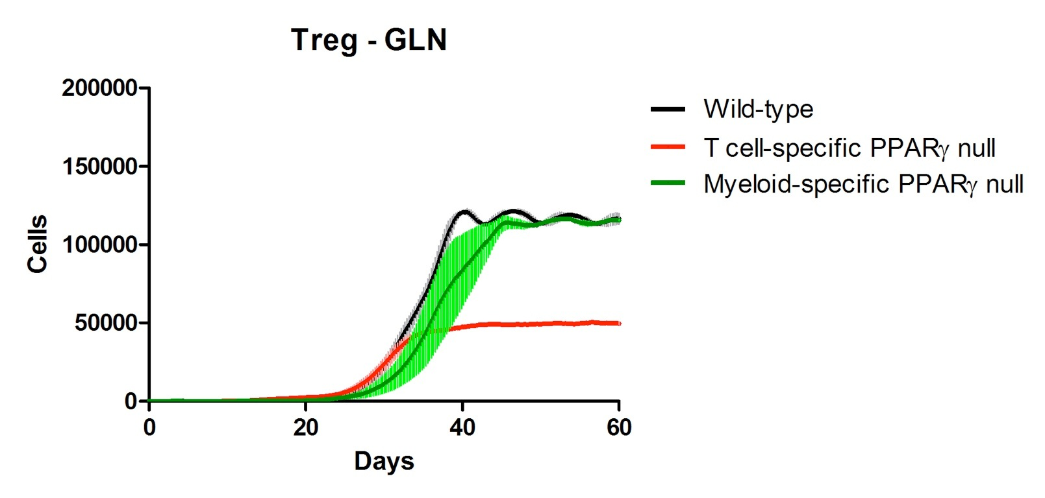
The H. pylori computational model
ENISI
ENteric Immunity SImulator

Slide 24
The H. pylori computational model
ENISI
ENteric Immunity SImulator
Does H. pylori exerts its pathology in a dose-dependent manner?

Slide 25
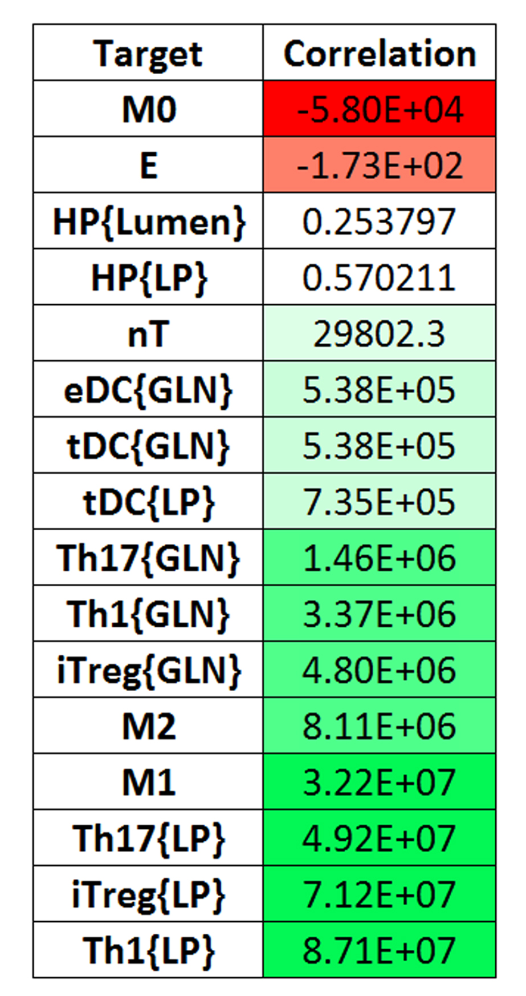
The H. pylori computational model
ENISI
ENteric Immunity SImulator
SENSITIVITY ANALYSIS

Slide 26
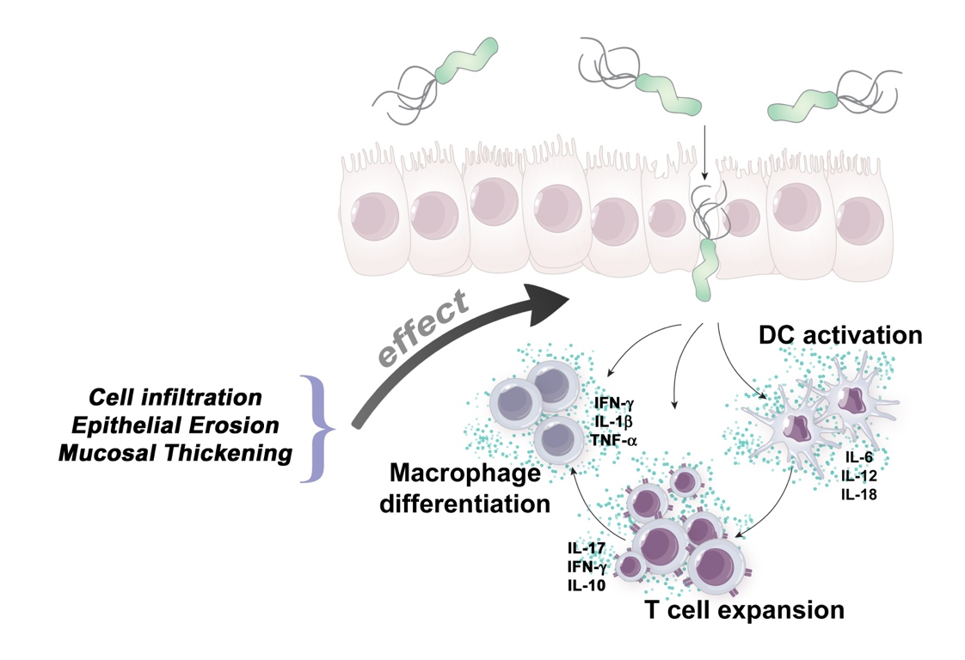
The H. pylori computational model
ENISI
ENteric Immunity SImulator
SENSITIVITY ANALYSIS

Slide 27
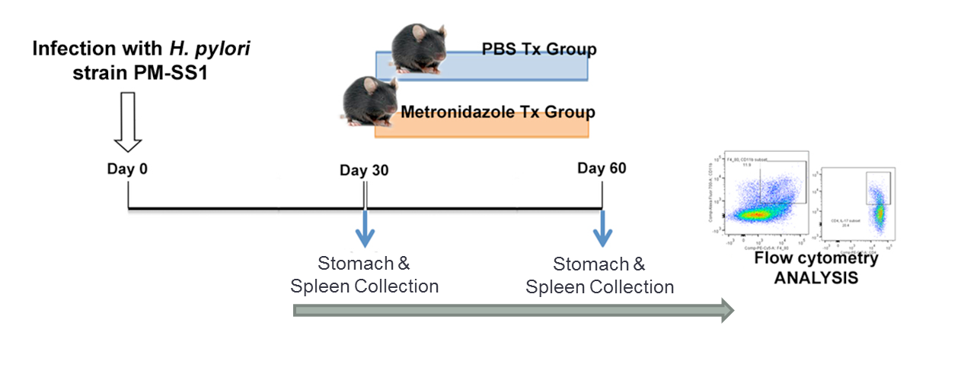
The H. pylori computational model
ENISI
ENteric Immunity SImulator
SENSITIVITY ANALYSIS
In vivo VALIDATION

Slide 28
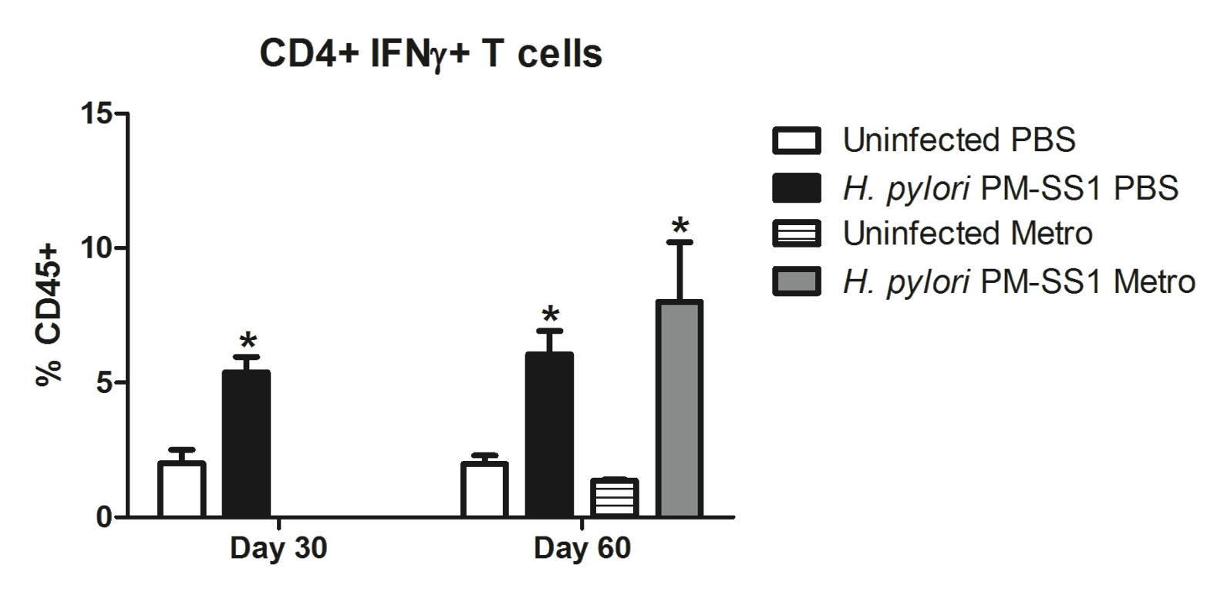
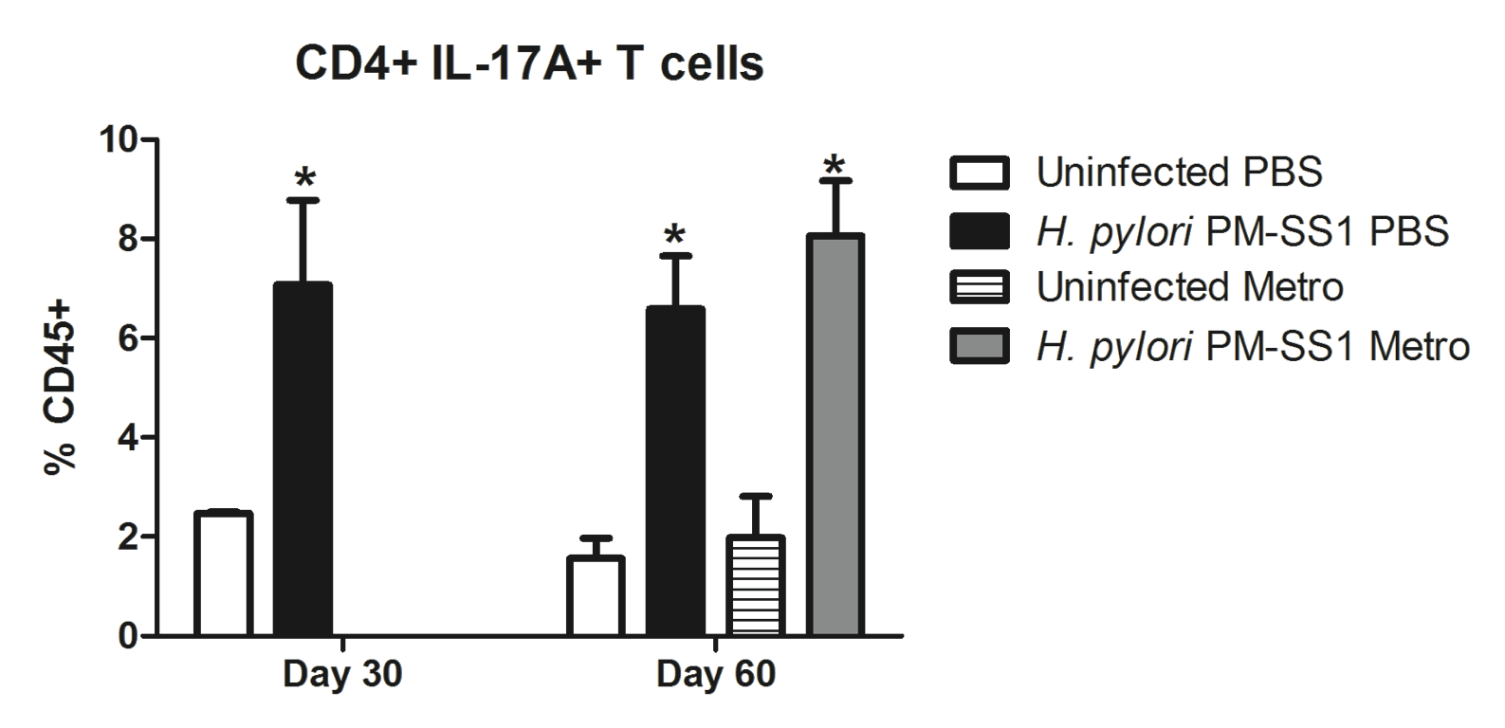
The H. pylori computational model
ENISI
ENteric Immunity SImulator
SENSITIVITY ANALYSIS
Helicobacter pylori is not triggering the inflammatory immune response in chronic stages of infection

Slide 29
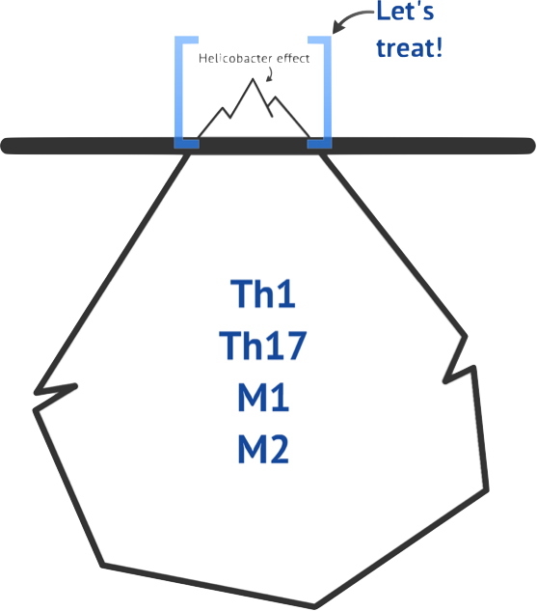
The H. pylori computational model
Current medical treatment will clear up the bacteria,
even during chronic infections
Is this the right approach?
INFLAMMATORY RESPONSE
UNDERNEATH

Slide 30
The H. pylori computational model
We need to find a better, more targeted approach to reduce the inflammatory response triggered by H. pylori

Slide 31
Discussion and Conclusions
Our results support that CD4+ T cells are crucial players for the development of H. pylori-associated gastritis
The ODE-modeling PE strategy helped to assign parameter values to the ABM
Our modeling results informed the experimental set up & analysis.
Sensitivity analysis showed how the immune response is the main driver for epithelial cell damage at the chronic stage of infection
The validation studies treating with metronidazole showed how at chronic stages we may be dealing with a more immune-mediated disease rather than pathogen-driven

